Slide 1
PC Maintenance: Preparing for A+ Certification
Chapter 11: Disk Drive Interfaces

Slide 2
Chapter 11 Objectives
Understand floppy drive interfaces
Explain IDE and ATA standards
Set jumpers for ATA drive installation
Explain SCSI standards
Set jumpers for SCSI drive installation
Physically install hard drives
Troubleshoot drive problems

Slide 3
Drive Interface Overview
Floppy
Integrated Device Electronics (IDE)
Small Computer Systems Interface (SCSI)
Universal Serial Bus (USB)

Slide 4
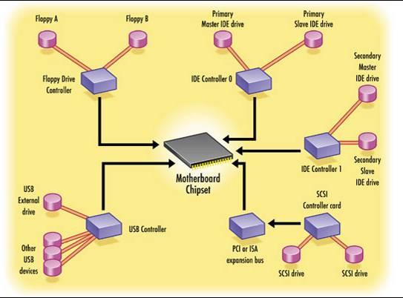
Drive Interface Controllers

Slide 5
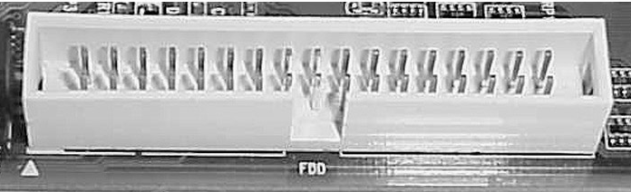
Floppy Interface
34-pin connector and ribbon cable
Usually labeled FDD
Only one per motherboard
Supports two drives (A and B)

Slide 6
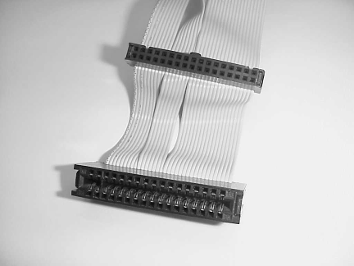
Floppy Drive Cable
Twist in a few wires between first and second drive connectors
Older cables may have alternate connector for 5.25” floppy drive

Slide 7
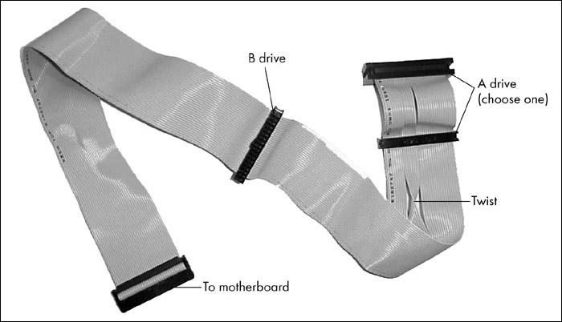
Floppy Drive Cable

Slide 8
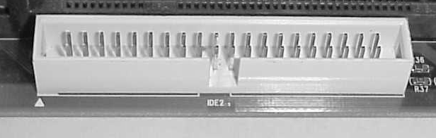
IDE Interface
40-pin connector and ribbon cable
Most motherboards have two
Each supports two drives (for a total of 4)
Hard disks, CD drives, ZIP drives, tape backup drives

Slide 9
IDE Versions
XT IDE (8-bit ISA): The original standard, for XT computers. Obsolete
MCA IDE (16-bit Micro Channel): Proprietary standard by IBM. Obsolete
ATA IDE (16-bit ISA): Current standard

Slide 10
ATA Versions
ATA-1: The original standard
ATA-2: Added support for other drives than hard disks
ATA-3: Added SMART error detection
ATA-4: Introduced UltraDMA/33, 33MB/sec

Slide 11
ATA Versions
ATA-5: UltraDMA/66, 66MB/sec
ATA-6: UltraDMA/100, 100MB/sec
ATA-7: UltraDMA/133, 133MB/sec
UltraDMA modes above /33
require 80-wire ribbon cable

Slide 12
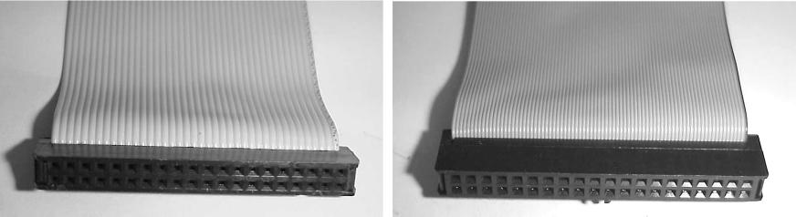
ATA Ribbon Cables

Slide 13
Serial ATA
High-speed serial connection between motherboard and drive
Serial cables can be longer than parallel ones
Cables are easier to work with
Speeds of 150MB/sec and higher possible

Slide 14
Slave/Master Jumpers
Two IDE devices per cable
First drive is Master (if second drive is also present) or Single (if alone)
Not all drives distinguish between Master and Single
Second drive is Slave
Cable Select setting relies on position on ribbon cable to determine Master/Slave status

Slide 15
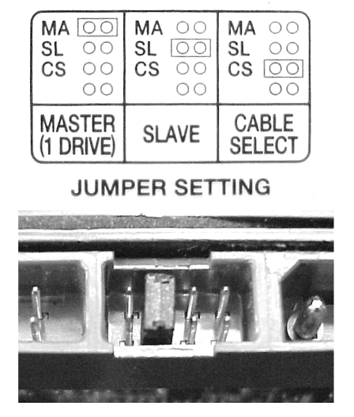
Slave/Master Jumpers

Slide 16
Mixing IDE Drives
On a single cable, all drives will revert to slowest ATA standard (speed) that is in common
Example: UltraDMA/33 and UltraDMA/100 drives together will operate at 33MB/sec

Slide 17
SCSI Interface
Small Computer Systems Interface
Popular on high-end systems, servers
More expensive than IDE
Interface not built into most motherboards
Requires controller card
Serial ATA promises to further erode the SCSI market

Slide 18
SCSI Advantages over IDE
Historically, overall higher throughput
Multiple SCSI drives can be chained together (at least 7), making SCSI well suited for RAIDs
Drives on same bus can share bandwidth better than IDE

Slide 19
Types of SCSI
SCSI-1: The original
  8-bit, 5Mhz bus
  Lack of standardization
  Device and expansion card typically purchased together as proprietary pair

Slide 20
Types of SCSI
SCSI-2: Standardized SCSI
  Standard 5MHz and Fast 10MHz
  Standard 8-bit width (standard or narrow)
  Wide 16-bit width
  Wide 32-bit width, never commercially successful

Slide 21
SCSI-3: Ultra SCSI
Fast-20: The original
  Ultra SCSI (8-bit, 20MBps)
  Ultra Wide (16-bit, 40MBps)
Fast-40
  Ultra2 (8-bit, 40MBps)
  Ultra2 Wide (16-bit, 80MBps)

Slide 22
SCSI-3: Ultra SCSI (continued)
Fast-80DT
(a.k.a. Ultra3, Ultra160, Ultra160+)
  16-bit width
  Data transfer up to 160MBps
Fast-160DT
(a.k.a. Ultra4, Ultra320)
  16-bit width
  Data transfer up to 320MBps

Slide 23
SCSI IDs
Each device has its own ID number
  On narrow SCSI (8-bit), 0 through 7
  On wide SCSI (16-bit), 0 through 15
SCSI ID set with jumper or switch on board, or in board’s built-in Setup utility
Plug-and-Play SCSI ID assignment available on most modern equipment

Slide 24
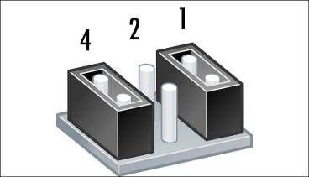
Setting SCSI Jumpers
Set ID numbers with binary system of numbering
Pins numbered right to left (usually)
On example below, ID is set to 5 (4 + 1)

Slide 25
SCSI Termination
Both ends of SCSI chain must be terminated
If chain ends at adapter on one end, jumper on adapter typically used
Terminator can be internal or external
Terminator can be active or passive

Slide 26
SCSI Termination
Passive termination: Uses resistors to block the signal
Active termination: Uses voltage regulators to block the signal. Much more effective.

Slide 27
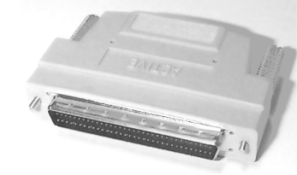
SCSI Termination
Built-in versus separate
  Some SCSI devices have jumpers for built-in termination
  A separate block can be attached for separate termination

Slide 28
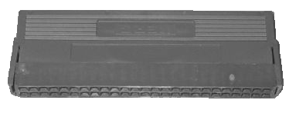
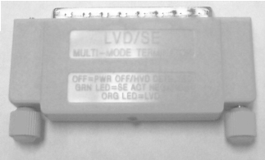
SCSI Termination
Internal vs. external
  Internal terminator terminates an internal SCSI chain (inside PC case)
  External terminator terminates an external SCSI chain (outside PC case)

Slide 29


More Ways to Categorize SCSI
Single-Ended: Standard (SE)
Low-Voltage Differential (LVD)
  Greater speeds, more devices, greater distance for chain
  All devices must support LVD, and must use LVD termination; otherwise devices revert to SE performance

Slide 30

More Ways to Categorize SCSI
High-Voltage Differential (HVD)
  Incompatible with SE and LVD
  Allows greater maximum distances
  Cannot be combined with any other SCSI devices on a chain
  Must use HVD termination

Slide 31
Prepare a Drive
Floppy: nothing required
IDE: Set master/slave jumpers
SCSI: Set SCSI ID jumpers and termination if required

Slide 32
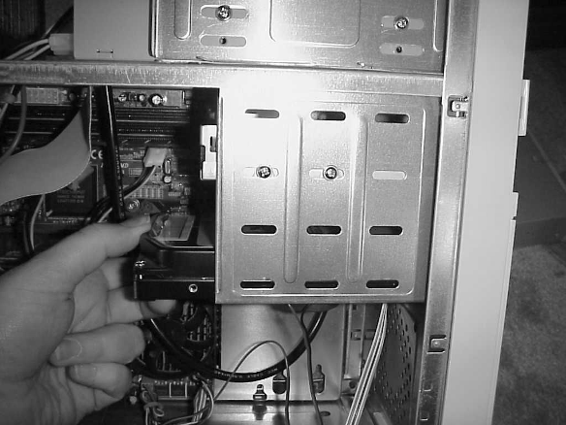
Mount the Drive in the Bay (Internal)

Slide 33
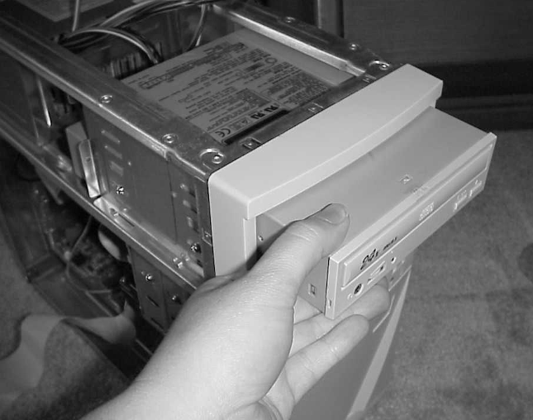
Mount the Drive in the Bay (External)

Slide 34
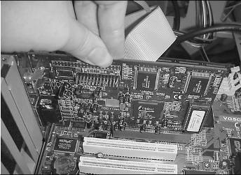
Install the SCSI Adapter
SCSI only
Set jumper on adapter for ID and termination if required
Install in PCI expansion slot

Slide 35
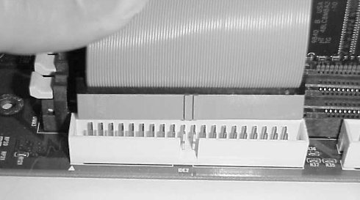
Connect Drive to Motherboard or Adapter
Red Stripe goes to Pin 1
Cable might be keyed to match notch in motherboard slot

Slide 36
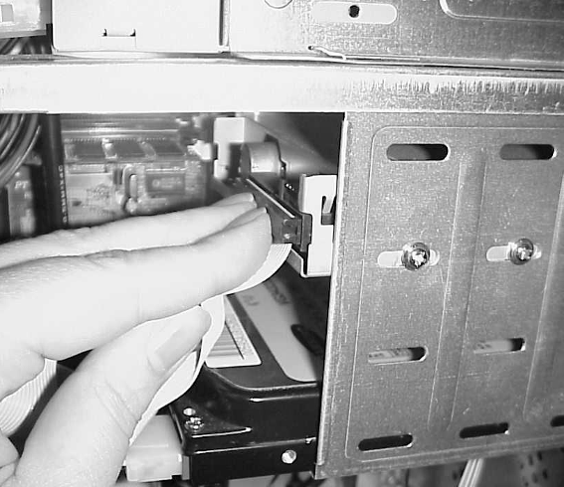
Connect Ribbon Cable to Drive

Slide 37
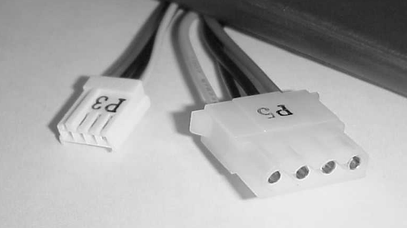
Connect Power Supply to Drive
Mini connector for floppy drives
Molex connector for all other drives

Slide 38
BIOS Configuration
Usually Plug-and-Play, no configuration needed (except floppy drive)
BIOS Setup will see drive immediately if attached directly to motherboard
  Primary master, primary slave, secondary master, secondary slave
Drive must be partitioned before OS will see it

Slide 39
Troubleshooting Dead Drive
Snug all cables
Check jumper settings
Check for Pin 1 cable orientation
Check BIOS setup to make sure interface is enabled
Try a different power supply connector
Try a different ribbon cable

Slide 40
Other Common Problems
Floppy light remains on
  Ribbon cable is backwards
Drive content does not refresh (floppy)
  Broken wire #34 on floppy drive cable
OS does not see drive
  Drive not partitioned yet

